Slide 1
Elections in Brazil - 2nd Round
We know on whom you would vote, before you knew...
(wanted to)
Amin Rasooli Elaine Resende Wender Xavier

Slide 2
Outline
Problem Review
Dataset
Methods
Analysis
Conclusion
Future work

Slide 3
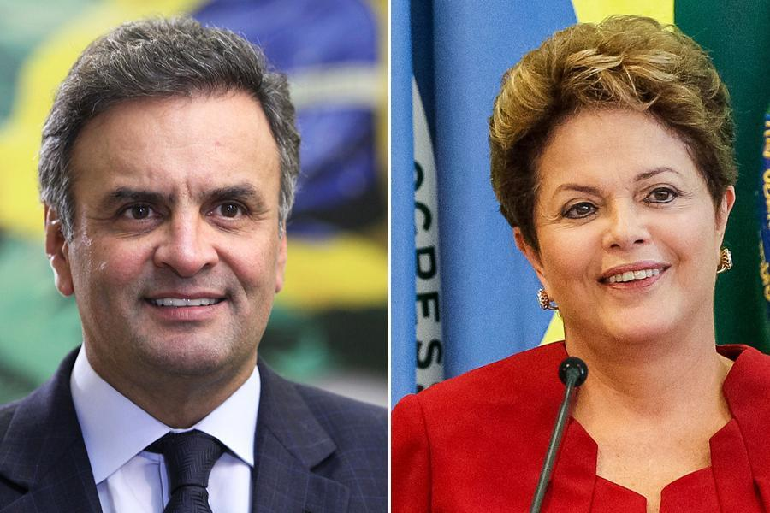
Problem Review
Elections time in Brazil
Could we find any patterns in Twitter and the results of an election?
Could we predict who will be the winner just using Twitter data?
Sentimental Analysis of voters’ Tweets.
Aécio Neves x Dilma Rousseff
Presidential Candidates
Source: Globo.com

Slide 4
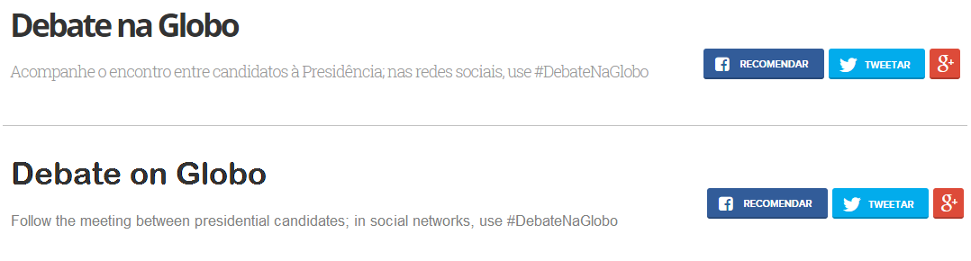

Methods and Dataset
Collecting the Dataset2:
Rest API - Collecting Tweets of a predetermined Hashtag (#DebateNaGlobo)
Streaming API - Collecting Tweets from determined location (Brazil)

Slide 5
Methods and Dataset
Collecting the Dataset1:
Streaming API and Rest API
From Fri Oct 24 (01:00am) - Oct 26
More than 100k Tweets
@DebateNaGlobo
Unique Tweets
8720

Slide 6
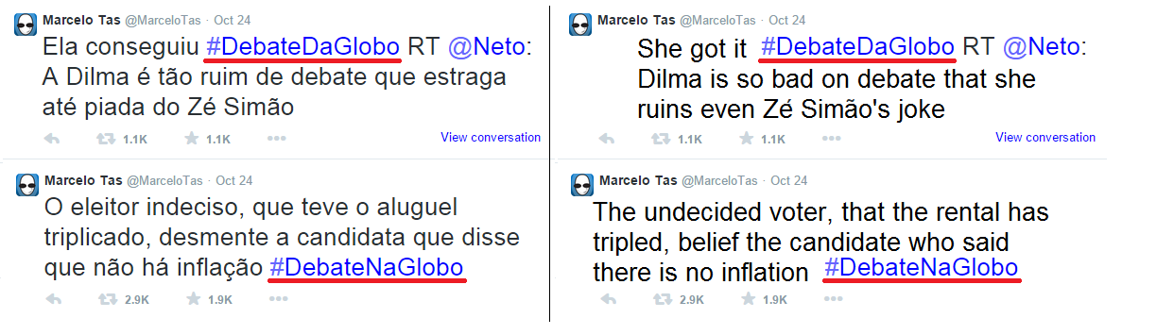
Analysis - Dataset 1
Most of the Retweeted Tweets showed us a problem ...
Tweets Translated

Slide 7
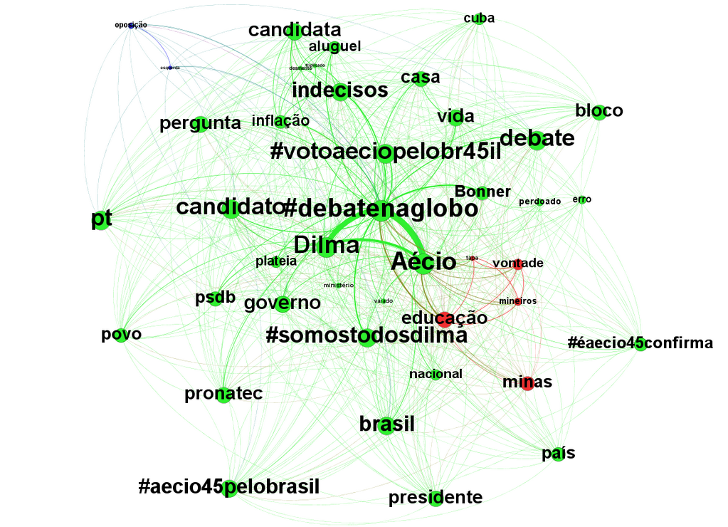
Analysis - Dataset 1
Graph of Mentions:
Titan - Graph Database

Slide 8
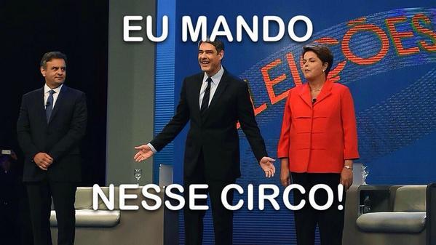
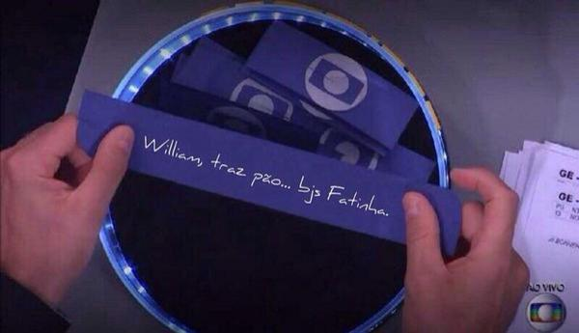
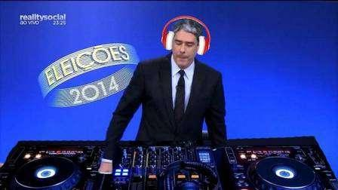
Analysis - Dataset 1
Tweets containing the word “Bonner”: 199 (2.28%)
I command this circus!
William, bring bread...Kisses, Fatima(His wife)

Slide 9
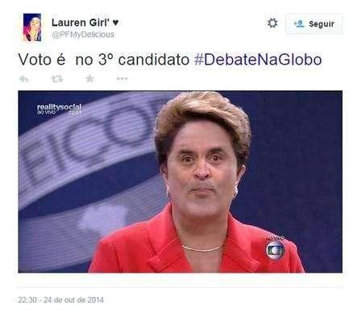
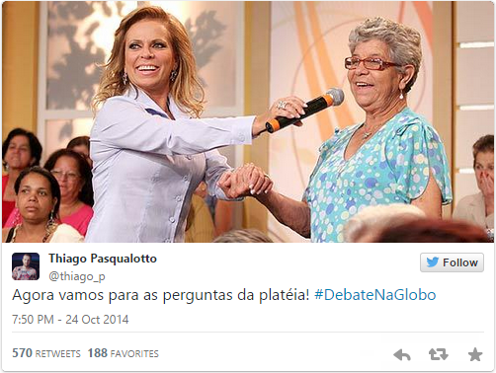
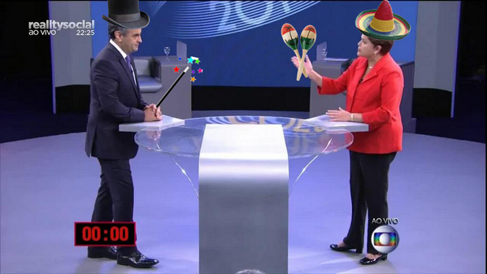
Analysis - Dataset 1
Tweets containing Pictures: 1970 (22.6%)
I Vote on the 3rd Candidate #DebateNaGlobo
Now it’s time for audience questions! #DebateNaGlobo

Slide 10
Analysis - Dataset 1
Total Hashtags found: 351 / Neutral: 250 (71.22%)
Pos(Dilma) - 31 (8.83%) / Neg(Dilma) - 10 (2.85%)
Pos(Aecio) - 51 (14.53%) / Neg(Aecio) - 9 (2.56%)
Total Tweets Analyzed: 1873 (21.47% of total Tweets)
Neutral: 9 (0.48%)
Pos(Dilma) - 992 (52.96%) / Neg(Dilma) - 53 (2.83%)
Pos(Aecio) - 796 (42.50%) / Neg(Aecio) - 23 (1.23%)

Slide 11
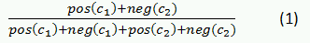
Analysis - Dataset 1
Computed Preference for:
Aecio: 0.45 / Dilma: 0.54
In the Equation 1, c_1 is the candidate for whom support is being computed while c_2 is the opposing candidates; pos(c) and neg(c) are, respectively, the number of positive and negative tweets mentioning candidates c. Notice that neutral tweets were not used since the don’t express a preference for a candidate.
Preference in the last poll:
Aecio: 0.48 / Dilma: 0.52
Limits of Electoral Predictions Using Twitter - Article
How (not) to predict elections - Article
Election Result:
Aecio: 0.484 / Dilma: 0.516

Slide 12
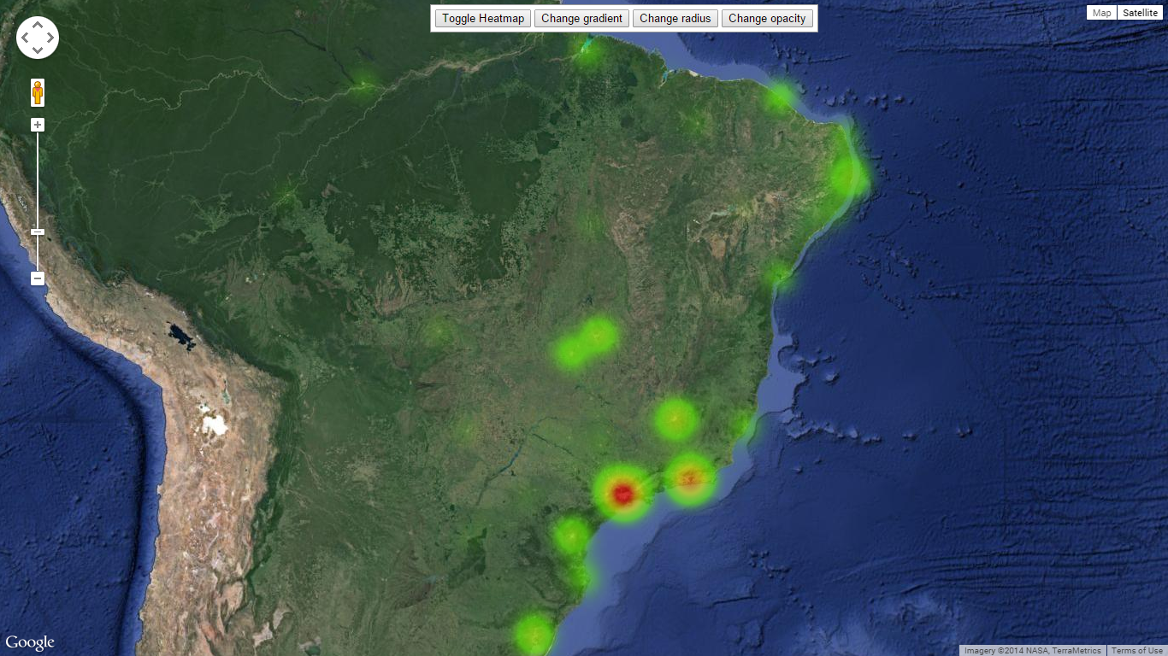
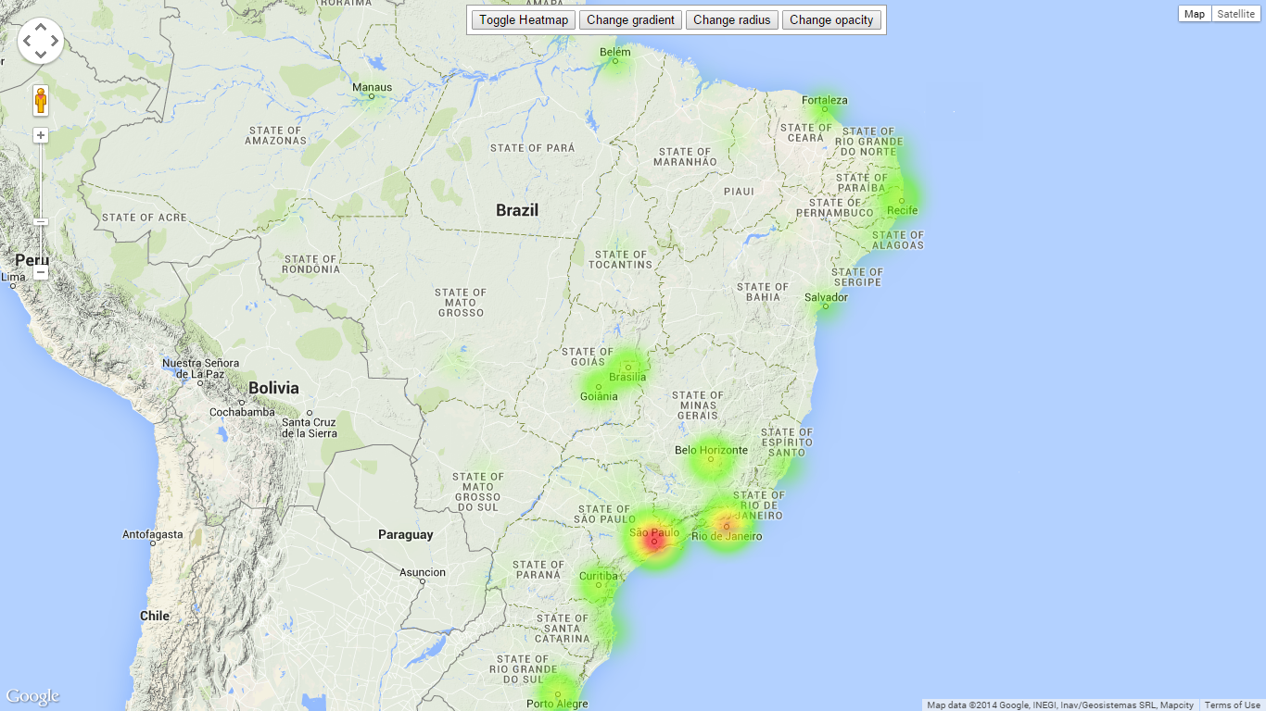
Analysis - Dataset 1
Google V3 API - Heat Maps
Users Selected: 1669
Users without Location: 583 (34.93%)

Slide 13
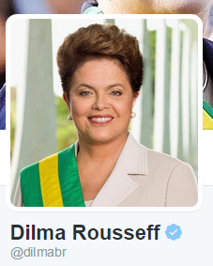
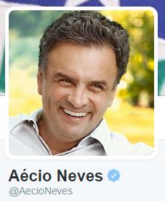
Dataset 2
Collecting the Dataset 2:
Streaming API
From Wed, Oct 22 until election day (26)
More than 100k tweets
@dilmabr and @AecioNeves
Corrected encoding of the files
Before eliminating rt’s
Aecio data 107431
Dilma data 128646
After eliminating rt’s
Aécio data 39327
Dilma data 65509

Slide 14

Method - Dataset 2
Tokenized tweets
THIS_IS_A_SYMBOL, THIS_IS_A_MENTION , THIS_IS_A_URL
Labels assignments
positive 2
negative 1
neutral 0
Labeled data for Dilma dataset 250/429
Labeled data for Aecio 180/330
Twitter Logo.
Source: Google Images

Slide 15
Method - Dataset 2
Vectorizing features
Around 1249 - Aecio
Around 1561 - Dilma
Naive Bayes
GaussianNB
Logistic Regression
TdfidVectorizer
Twitter Logo.
Source: Google Images

Slide 16
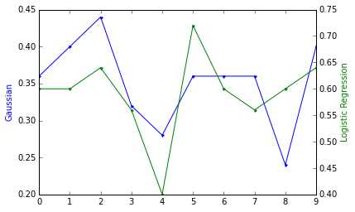
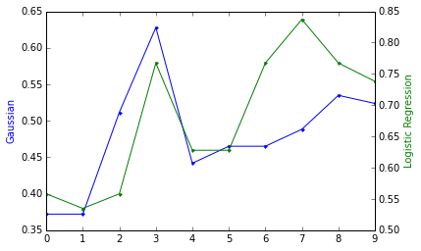
Results - Dataset 2
DBDilma 250
Technique | Accuracy
Logistic Reg | 0.61
GaussianNB | 0.368
TfidfVec | 0.608
DBDilma 429
Technique | Accuracy
Logistic Reg | 0.66
GaussianNB | 0.48
TfidfVec | 0.678
Twitter Logo.
Source: Google Images

Slide 17
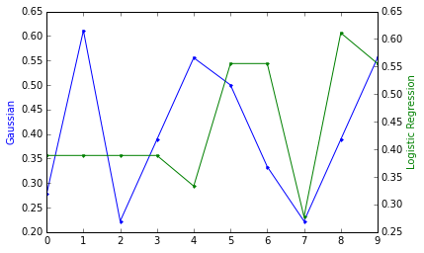
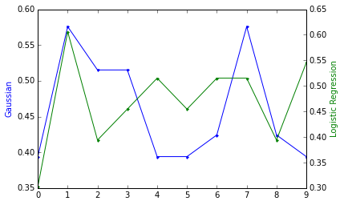
Results - Dataset 2
DBAécio 180
Technique | Accuracy
Logistic Reg | 0.44
GaussianNB | 0.422
TfidfVec | 0.472
DBAécio 330
Technique | Accuracy
Logistic Reg | 0.47
GaussianNB | 0.478
TfidfVec | 0.487
Twitter Logo.
Source: Google Images

Slide 18
Conclusions
Size of training set helps to improve the accuracy.
Most of the tweets did not have sentiment. We can say that this is the reason of the low accuracy.
Non-uniform encodings affect the results considerably.
Vectorizer also influences the accuracy.
No commonly accepted way exists for counting the votes in Twitter (unique users, volume of Tweets or sentiment analysis).
Not every age, gender, social, and ethnic group are equally represented on the dataset.
Several tweets have ironic content which can complicate the analysis.
Users tend to use other hashtags which are not related to the elections.
Twitter Logo.
Source: Google Images

Slide 19
Future Work
Increase size of training set
Analyze geolocated Tweets
Select the special features
Collect encoded data
Consider the “mentions” to manual classification for training set
Twitter Logo.
Source: Google Images

Slide 20

Thank you!
Questions
Questions
Twitter Logo.
Source: Google Images

